Slide 1
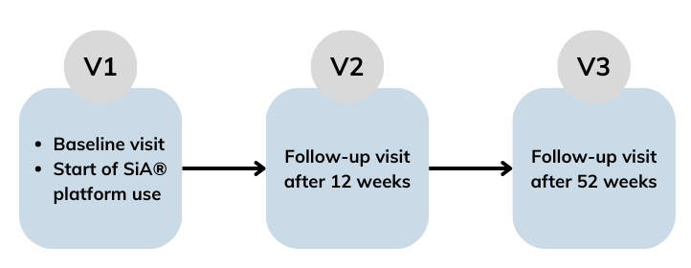
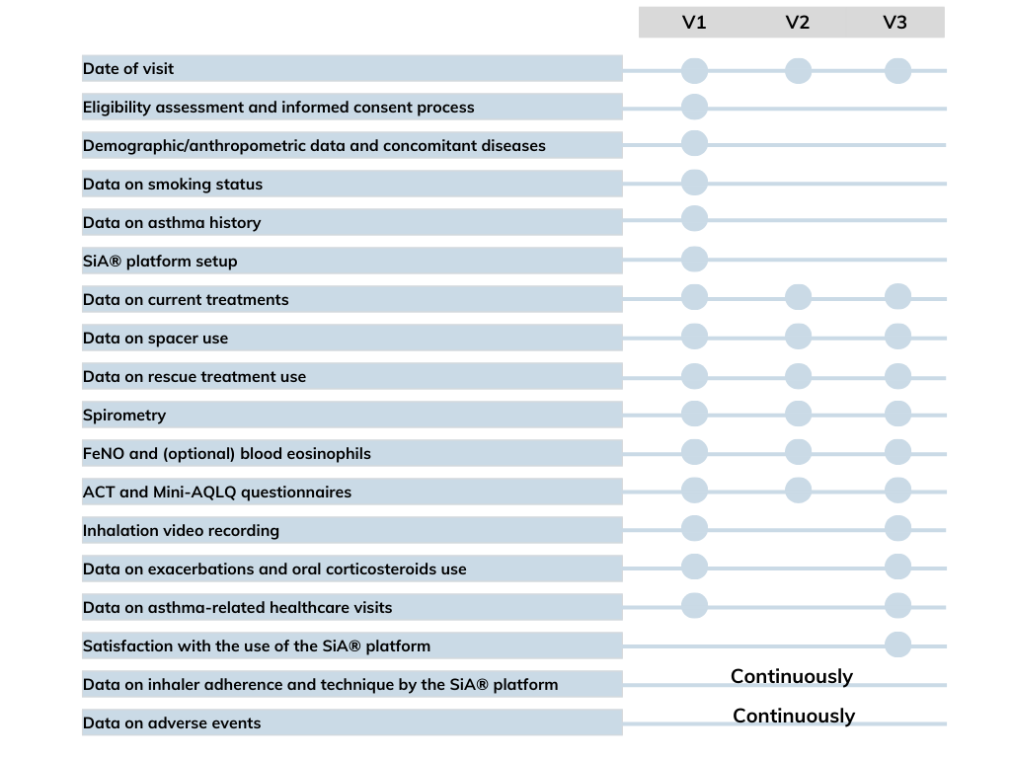
Study protocol: Effect of a Smart Inhaler Add-On on Adherence and Inhaler Technique in Patients with Poorly Controlled Asthma
J. Aggerholm Bækdal¹, N. Krogh², G. Sakhare³, E. Bendstrup^{4,5}, C. Suppli Ulrik^{1,6}, J. Schmid^{4,5}
¹Respiratory Research Unit Hvidovre, Department of Respiratory Medicine, Copenhagen University Hospital – Hvidovre, Denmark; ²Chiesi Pharma AB, Nordics, Sweden; ³Briota ApS, Denmark; ⁴Department of Respiratory Diseases and Allergy, Aarhus University Hospital, Denmark; ⁵Department of Clinical Medicine, Aarhus University, Denmark; ⁶Institute of Clinical Medicine, University of Copenhagen, Copenhagen, Denmark
*Presenting author; csulrik@dadlnet.dk
BACKGROUND AND OBJECTIVES
DEVICE
Achieving good adherence to controller medication is a cornerstone of asthma management, as good adherence has been associated with reduced airway inflammation, improved lung function, lower use of SABA and systemic corticosteroids, fewer hospitalizations, and lower mortality rates (1,2).
However, many patients struggle with these aspects, leading to poor symptom control and a higher risk of exacerbations.
This study (SiASMARTer, NTC06908421) aims to evaluate the impact of the SiA®SMARTer platform - a digital smart platform consisting of an app and an add-on module connected to a pressurized metered-dose inhaler delivering triple therapy (ICS/LABA/LAMA)
Assess the effectiveness of the SiA®SMARTer platform implementation over a 52-week period in improving adherence to controller medication and inhaler technique in patients with poorly controlled asthma.
Assess if the SiA®SMARTer platform can effectively discriminate between uncontrolled asthma caused by an inadequate therapeutic strategy – therefore, necessitating treatment escalation, possible add-on controllers or biologic treatments – and that resulting from poor adherence and/or incorrect inhaler technique.
The SiA®SMARTer platform consists of three main components designed to enhance treatment adherence and inhaler technique through real-time feedback, data analysis, and personalized support.
The first component is the Smart Inhaler Cap (RespiPRO™), an innovative cap that collects inhalation data for processing and display in a dedicated mobile application. It is reusable and equipped with a replaceable battery to ensure long-term usability.
The second component is the SiA® Mobile Application, attached to the pMDI, which includes several key features to support patients in adherence and good inhaler technique. It provides an Adherence Score and an Inhaler Technique Score, accessible through a user-friendly dashboard. The app includes personalized reminders, and smart notifications to promote proper medication use. Additionally, it features an Inhaler Technique Analytics Dashboard, which provides personalized tips to help patients improve their inhaler technique, and easily accessible inhaler technique instructions and videos.
The third component is the SiA® Dashboard for health care professionals allowing monitoring patient adherence and inhaler technique through the integrated Adherence Analytics Dashboard and an Inhaler Technique Dashboard.
METHODS
Figure 1. Patient flow chart.
Table 1. Objectives and Endpoints
Study design
This observational, single-arm, open-label study study (NCT06908421) aims to enrol 60 patients from two sites (Copenhagen University Hospital – Hvidovre and Aarhus University Hospital in Denmark.
Main inclusion criteria
≥18 years
objectively verified asthma diagnosis according to GINA guidelines (3)
poorly controlled asthma (FeNO levels >25 ppb)
receiving single-inhaler triple therapy (ICS/LABA/LAMA with BDP/FF/G 87μg/5μg/9μg (beclomethasone dipropionate, formoterol fumarate, glycopyrronium), +/- spacer delivered with a pressurized metered dose inhaler, pMDI) for more than four weeks prior to enrolment and prescribed with rescue medication (pMDI SABA)
Exclusion criteria
participation in a clinical trial within four weeks prior to enrolment or planned participation in another clinical trial during the observational period
use of systemic corticosteroids as maintenance (controller) medication or biologic treatments (such as monoclonal antibodies)
concomitant diagnosis of chronic obstructive pulmonary disease (COPD)
current or previous history of lung cancer
respiratory tract infection or asthma exacerbation within four weeks prior to enrolment
administration of systemic corticosteroids within four weeks before enrolment
Enrolled patients receiving medium dose single-inhaler triple therapy (ICS/LABA/LAMA, 87μg/5μg/9μg) through pMDI at baseline could switch to high dose BDP/FF/G (172μg/5μg/9μg, pMDI) as judged by the physicians.
At baseline, participants will begin using the SiA®SMARTer platform, which includes, on the patient side a smart inhaler cap, a patient app and on the physician side a dashboard.
Data on adherence and inhaler technique will be continuously collected through the SiA®SMARTer platform, and adverse events will be monitored.
Objectives |  | Endpoints
Primary
To evaluate the impact of the SiA®SMARTer platform on the type 2 inflammation biomarker FeNO |  | Change in FeNO levels from baseline at weeks 12 and 52
Secondary
To evaluate the impact of the SiA®SMARTer platform on adherence to SITT and inhaler technique |  | Change in inhaler adherence and technique scores from baseline at weeks 12 and 52
To evaluate the impact of the SiA®SMARTer platform on asthma control |  | Change in ACT scores from baseline at weeks 12 and 52
To evaluate the impact of the SiA®SMARTer platform on health-related quality of life |  | Change in mini-AQLQ scores from baseline at weeks 12 and 52
To evaluate the impact of the SiA®SMARTer platform on lung function |  | Change in lung function parameters (change in mean FEV1, FEV1 %-predicted, FEV1/FVC ratio, FEF25-75) from baseline at weeks 12 and 52
To evaluate the impact of the SiA®SMARTer platform on shifts in FeNO category |  | Change in FeNO category (normal, intermediate, high) from baseline at weeks 12 and 52
To evaluate the impact of the SiA®SMARTer platform on annualized exacerbations rates |  | Change in annualized exacerbation rates from baseline at week 52
To evaluate the impact of the SiA®SMARTer platform on the use of rescue medication (SABA) |  | Change in SABA use from baseline (first 7 days) at weeks 12 and 52
To evaluate patient satisfaction with the of the SiA®SMARTer platform |  | Satisfaction score at week 52 assessed using a customized questionnaire
Figure 1. V1, visit 1; V2, visit 2; V3, visit 3
Figure 2. Data collection and clinical assessment.
Figure 2. Data collection and clinical assessment according to visits. FeNO, fractional exhaled nitric oxide; ACT, Asthma Control Test; Mini-AQLQ, Mini Asthma Quality of Life Questionnaire; V1, visit 1; V2, visit 2; V3, visit 3.
As an exploratory objective, the study will evaluate the impact of the SiA®SMARTer platform on morbidity status. The dedicated endpoint will analyse changes in healthcare utilization costs, including emergency room visits, hospital visits, and hospitalizations, comparing the 52 weeks prior to enrolment with the 52-week study period.
RESULTS AND CONCLUSIONS
Good adherence to controller medication and correct inhaler technique is essential for effective asthma management.
This study may offer valuable insights into whether a digital platform can enhance adherence and inhaler technique, and by that improve asthma control. Additionally, it may help discriminate patients requiring therapy escalation from those with poor control due to non-adherence or incorrect inhaler technique.
REFERENCES
DISCLOSURES
1. Braido F, Baiardini I, Blasi F, Pawankar R, Canonica GW. Adherence to asthma treatments: ‘we know, we intend, we advocate’. Current Opinion in Allergy & Clinical Immunology. 2015 Feb;15(1):49–55.
2. Williams LK, Pladevall M, Xi H, Peterson EL, Joseph C, Lafata JE, et al. Relationship between adherence to inhaled corticosteroids and poor outcomes among adults with asthma. Journal of Allergy and Clinical Immunology. 2004 Dec;114(6):1288–93.
3. Asthma Management and Prevention - Global Initiative for Asthma - GINA [Internet]. [cited 2025 Feb 10]. Available from: https://ginasthma.org/now-available-2024-summary-guide-for-asthma-management-and-prevention/
This study was funded by Chiesi Pharma AB (Stockholm, Sweden). Briota ApS (Copenhagen, Denmark) supports the study by providing the SiA®SMARTer platform, including the RespiPRO™ inhaler caps and related technical support. Medical writing support was provided by Sabrina Meisgen Chiesi Pharma AB and Chiesi Pharma AB reviewed and approved the poster.
JAB: Fees for lectures from Novo Nordisk and travel/conference grant from Chiesi Pharma AB; NK: employee Chiesi Pharma AB; GS: cofounder Briota ApS; CSU: Fees for lectures, participation in advisory boards from Chiesi, AstraZeneca, GSK, TEVA, Pfizer, Sanofi, IQVIA, Takeda, Roche, Novo Nordisk, Hikma Pharmaceuticals, Berlin Chemie, Boehringer Ingelheim, TFF Pharmaceuticals and Novartis. EB and JMS: no conflicts of interest.
Notes:
Brand guidance slide

